Slide 1
Principles of Distributed Database Systems
M. Tamer Özsu
Patrick Valduriez

Slide 2
Outline
Distributed Query Processing
Overview
Query Modification
Query Decomposition
Data Localization
Query Translation
Distributed Cost Model
Distributed Query Optimization
Join Ordering
Dynamic Approach
Static Approach
Hybrid Approach
Adaptive Query Processing

Slide 3
Query Processing in a DDBMS
High level user query
Query
Processor
Low-level data manipulation
commands for D-DBMS

Slide 4
Query Processing Components
Query language
SQL:
Query execution
The steps that one goes through in executing high-level (declarative) user queries.
Query optimization
How do we determine the “best” execution plan?
Notes:
Query Execution:
Computers cannot understand high-level language so we convert high-level language to machine-understandable language.[Ex: Compiler and Interpreters for C, Java, and Python]
Query Optimization
How do you run the query faster?
There are 100 plans/queries to execute one thing, so we need to find which one is fast.
We cannot run 100 queries so we estimate the faster one.

Slide 5
Selecting Alternatives
SELECT ENAME
FROM EMP NATURAL JOIN ASG
WHERE RESP = "Manager"
Plan 1
Π_{ENAME}(σ_{RESP=“Manager”∧EMP.ENO=ASG.ENO}(EMP×ASG))
Plan 2
Π _{ENAME}(EMP ⋈_{ENO} (σ_{RESP=“Manager”} (ASG))
Plan 2 avoids Cartesian product by applying other join algorithms and applies Selection before join, so may be “better”
Notes:
2 operations – join and select
Plan 1: First join and then select
Plan 2: First select and then join (More optimized)
This example is a centerized query operation.

Slide 6
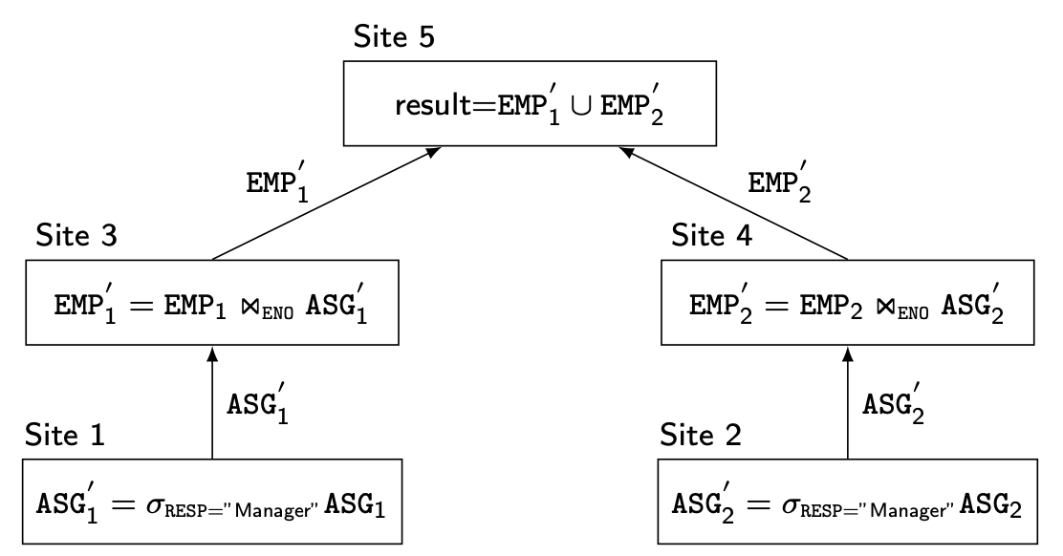
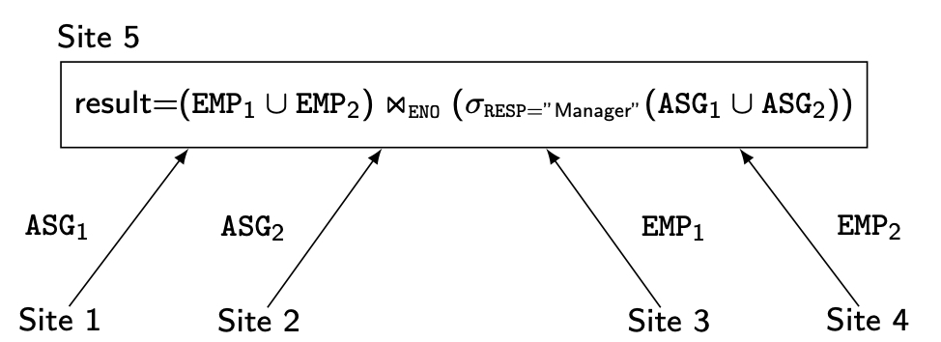
What is the Problem?
Site 1
Site 2
Site 3
Site 4
Site 5
ASG₁= σ _{ENO≤“E3”}(ASG)
EMP₁= σ _{ENO≤“E3”}(EMP)
Result
ASG₂= σ _{ENO>“E3”}(ASG)
EMP₂= σ _{ENO>“E3”}(EMP)
Plan 2
Plan 1
Notes:
This is a distributed query join.
ASG and EMP are horizontally fragmented.
Do the query and the result goes to site-5
Plan-1
Sile-1: selection and the result to copies to site 3
Sile 3: Join
Similarly, site-2 (selection) and site-4 (join)
Site-5: Union

Slide 7
Example
EMP
ASG
ENO | ENAME | TITLE
E1 | J. Doe | Elect. Eng.
E2 | M. Smith | Syst. Anal.
E3 | A. Lee | Mech. Eng.
E4 | J. Miller | Programmer
E5 | B. Casey | Syst. Anal.
E6 | L. Chu | Elect. Eng.
E7 | R. Davis | Mech. Eng.
E8 | J. Jones | Syst. Anal.
ENO | PNO | RESP | DUR
E1 | P1 | Manager | 12
E2 | P1 | Analyst | 24
E2 | P2 | Analyst | 6
E3 | P3 | Consultant | 10
E3 | P4 | Engineer | 48
E4 | P2 | Programmer | 18
E5 | P2 | Manager | 24
E6 | P4 | Manager | 48
E7 | P3 | Engineer | 36
E7 | P5 | Engineer | 23
E8 | P3 | Manager | 40
PROJ
SKILL (PAY)
PNO | PNAME | BUDGET
P1 | Instrumentation | 150000
P2 | Database Develop. | 135000
P3 | CAD/CAM | 250000
P4 | Maintenance | 310000
TITLE | SAL
Elect. Eng. | 40000
Syst. Anal. | 34000
Mech. Eng. | 27000
Programmer | 24000

Slide 8
Cost of Alternatives
Assume
size(EMP) = 400 ( EMP1 has 200, and EMP2 has 200), size(ASG) = 1000
tuple access cost = 1 unit; tuple transfer cost = 10 units
20 managers (Site 1 has 10, and Site 2 has 10) in relation ASG.
Plan 1
produce ASG': 1000 ∗ tuple access cost 1000
transfer ASG' to the sites of EMP: (10+10) ∗ tuple transfer cost 200
produce EMP': 200 ∗ 10 ∗ tuple access cost ∗ 2 4000
transfer EMP' to result site: (10+10) ∗ tuple transfer cost 200
Total Cost 5400
Plan 2
transfer EMP to site 5: 400 ∗ tuple transfer cost 4,000
transfer ASG to site 5: 1000 ∗ tuple transfer cost 10,000
produce ASG': 1000 ∗ tuple access cost 1,000
join EMP and ASG': 400 ∗ 20 ∗ tuple access cost 8,000
Total Cost 23,000
Notes:
This is one way to estimate the cost.
Estimate the best plan.
Absolute value is not required – Make assumptions.
Size – 400 means 400 tuples.
According to the calculations, we can conclude that plan 1 is better than plan 2.
The main point is to reduce the number of transfers because that is costly.

Slide 9
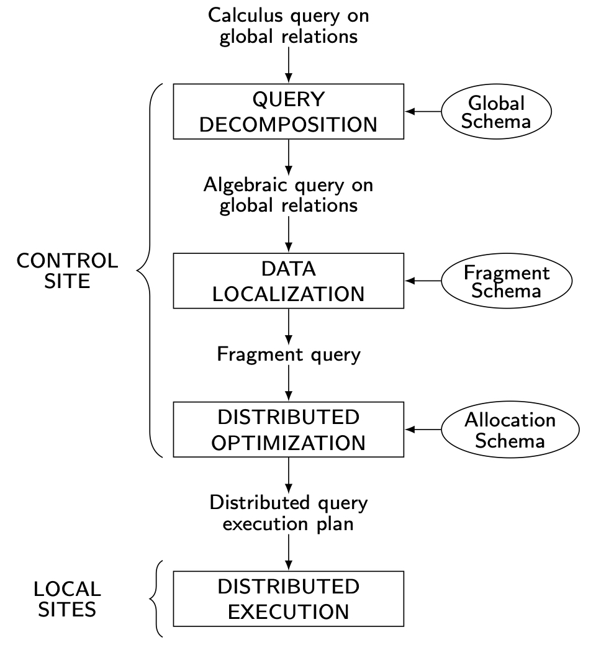
Distributed Query Processing Methodology
Notes:
Data localization are not required in centralized query proceedings.

Slide 10
Query Modification before Decomposition
Input : Query on global relations
Normalization
manipulate query quantifiers and qualification
Analysis
detect and reject “incorrect” queries
Simplification
eliminate redundant predicates
Restructuring
more than one translation is possible
use transformation rules
Notes:
Query on global relations means: Fragments are considered as one table.

Slide 11
Normalization
The input query may be arbitrarily complex, depending on the facilities provided by the language.
It is the goal of normalization to transform the query to a normalized form to facilitate further processing.
Notes:
1st normal form, 2nd normal form, etc
If it is not in normal form then decompose it to normalize it.

Slide 12
Normalization
There are two possible normal forms for the predicate, one giving precedence to the AND (^) and the other to the OR (∨).
Put into normal form
Conjunctive normal form
(p₁₁∨ p₁₂ ∨ … ∨ p_{1n}) ∧ … ∧ (p_{m1} ∨ p_{m2} ∨ … ∨ p_{mn})
Disjunctive normal form
(p₁₁ ∧ p₁₂ ∧ … ∧ p_{1n}) ∨ … ∨ (p_{m1} ∧ p_{m2} ∧ … ∧ p_{mn})
OR's mapped into union, AND's mapped into join or selection
Notes:
Conjunction means ’and’
Disjunction means ‘or’

Slide 13
Normalization
Equivalence rules for logical operations (∧, ∨, and ¬):
1. p1 ∧ p2 ⇔ p2 ∧ p1
2. p1 ∨ p2 ⇔ p2 ∨ p1
3. p1 ∧ (p2 ∧ p3) ⇔ (p1 ∧ p2) ∧ p3
4. p1 ∨ (p2 ∨ p3) ⇔ (p1 ∨ p2) ∨ p3
5. p1 ∧ (p2 ∨ p3) ⇔ (p1 ∧ p2) ∨ (p1 ∧ p3)
6. p1 ∨ (p2 ∧ p3) ⇔ (p1 ∨ p2) ∧ (p1 ∨ p3)
7. ¬(p1 ∧ p2) ⇔ ¬p1 ∨¬p2
8. ¬(p1 ∨ p2) ⇔ ¬p1 ∧¬p2
9. ¬(¬p) ⇔ p

Slide 14
Normalization
In the disjunctive normal form (OR), the query can be processed as independent conjunctive subqueries linked by unions (corresponding to the disjunctions).
However, this form may lead to replicated join and select predicates, as shown in the following example.
The reason is that predicates are very often linked with the other predicates by AND.
The use of rule 5 mentioned above, with p1 as a join or select predicate, would result in replicating p1.
5. p1 ∧ (p2 ∨ p3) ⇔ (p1 ∧ p2) ∨ (p1 ∧ p3)
The conjunctive normal form is more practical since query qualifications typically include more AND than OR predicates.
Notes:
Disjuntion = Conjuntion + Union
Many ‘and’ is better than many ’or’ because tuples get reduced. Any one is not satisfied then we do not have to worry about that.

Slide 15
Normalization
Let us consider the following query on the engineering database that we have been referring to: “Find the names of employees who have been working on project P1 for 12 or 24 months”
The query expressed in SQL is
SELECT ENAME
FROM EMP, ASG
WHERE EMP.ENO = ASG.ENO AND ASG.PNO = "P1“ AND (DUR = 12 OR DUR = 24)
The qualification in conjunctive normal form is
EMP.ENO = ASG.ENO ^ ASG.PNO = “P1” ^ (DUR = 12 ∨ DUR = 24)
while the qualification in disjunctive normal form is
(EMP.ENO = ASG.ENO ^ ASG.PNO = “P1” ^ DUR = 12) ∨
(EMP.ENO = ASG.ENO ^ ASG.PNO = “P1” ^ DUR = 24)
In the latter form, treating the two conjunctions independently may lead to redundant work if common subexpressions are not eliminated.

Slide 16
Query Modification before Decomposition
Input : Query on global relations
Normalization
manipulate query quantifiers and qualification
Analysis
detect and reject “incorrect” queries
Simplification
eliminate redundant predicates
Restructuring
more than one translation is possible
use transformation rules

Slide 17
Analysis
Query analysis enables rejection of normalized queries for which further processing is either impossible or unnecessary.
The main reasons for rejection are that the query is type incorrect or semantically incorrect.
When one of these cases is detected, the query is simply returned to the user with an explanation. Otherwise, query processing is continued.
Notes:
After normalization, sometimes it's not possible to continue because the query may be incorrect(type incorrect or semantic incorrect).

Slide 18
Analysis
Type incorrect
If any of its attribute or relation names are not defined in the global schema
If operations are applied to attributes of the wrong type
The technique used to detect type incorrect queries is similar to type checking for programming languages
The following SQL query on the engineering database is type incorrect for two reasons
First, attribute E# is not declared in the schema
Second, the operation “>200” is incompatible with the type string of ENAME
SELECT E#
FROM EMP
WHERE ENAME > 200
Notes:
Incorrect Query: E# does not exist, and ENAME is not an integer.

Slide 19
Analysis
Semantically incorrect
Components do not contribute in any way to the generation of the result
In the context, it is not possible to determine the semantic correctness of general queries
To detect
connection graph (query graph)
join graph
Notes:
Means unnecessary.

Slide 20
Analysis
Semantically incorrect
To detect: connection graph (query graph)
This is based on the representation of the query as a graph, called a query graph or connection graph.
In a query graph, one node indicates the result relation, and any other node indicates an operand relation.
An edge between two nodes (one of which does not correspond to the result) represents a join, whereas an edge whose destination node is the result represents a project.
Furthermore, a non-result node may be labeled by a select or a self-join (join of the relation with itself) predicate.
Notes:
Edge not connected to the result is ‘join’.
Edge connected to the result is the ‘project’.

Slide 21
Analysis
Semantically incorrect
To detect: join graph
An important subgraph of the query graph is the join graph, in which only the joins are considered.
The join graph is particularly useful in the query optimization phase

Slide 22
Analysis – Example
“Find the names and responsibilities of programmers who have been working on the CAD/CAM project for more than 3 years.”
SELECT ENAME,RESP
FROM EMP, ASG, PROJ
WHERE EMP.ENO = ASG.ENO
AND ASG.PNO = PROJ.PNO
AND PNAME = "CAD/CAM"
AND DUR ≥ 36
AND TITLE = "Programmer"
Query graph
Join graph
DUR≥36
ASG
ASG
EMP.ENO=ASG.ENO
ASG.PNO=PROJ.PNO
EMP.ENO=ASG.ENO
ASG.PNO=PROJ.PNO
TITLE =
“Programmer”
EMP
RESP
PROJ
EMP
PROJ
ENAME
RESULT
PNAME=“CAD/CAM”
Notes:
Node, Edge in a graph
Edge not connected to the result is ‘join’.
Edge connected to the result is the ‘project’.
Self loop may be ‘select’.

Slide 23
Analysis
If the query graph is not connected, the query may be wrong
SELECT ENAME,RESP
FROM EMP, ASG, PROJ
WHERE EMP.ENO = ASG.ENO
AND PNAME = "CAD/CAM"
AND DUR ≥ 36
AND TITLE = "Programmer"
SELECT ENAME,RESP
FROM EMP, ASG, PROJ
WHERE EMP.ENO = ASG.ENO
AND ASG.PNO = PROJ.PNO
AND PNAME = "CAD/CAM"
AND DUR ≥ 36
AND TITLE = "Programmer"
DUR≥36
ASG
EMP.ENO=ASG.ENO
TITLE =
“Programmer”
EMP
RESP
PROJ
ENAME
RESULT
PNAME=“CAD/CAM”
Notes:
From the left query – one join is missing as we can see from the graph.

Slide 24
Query Modification before Decomposition
Input : Query on global relations
Normalization
manipulate query quantifiers and qualification
Analysis
detect and reject “incorrect” queries
possible for only a subset of them
Simplification
eliminate redundant predicates
Restructuring
more than one translation is possible
use transformation rules

Slide 25
Simplification
How?
Elimination of redundancy
Idempotency (unchanged) rules for transformation
1. p ∧ p ⇔ p
2. p ∨ p ⇔ p
3. p ∧ true ⇔ p
4. p ∨ false ⇔ p
5. p ∧ false ⇔ false
6. p ∨ true ⇔ true
7. p ∧ ¬p ⇔ false
8. p ∨ ¬p ⇔ true
9. p1 ∧ (p1 ∨ p2) ⇔ p1
10. p1 ∨ (p1 ∧ p2) ⇔ p1
Notes:
The idempotency rule means even though you apply there is no change.

Slide 26
Simplification – Example
SELECT TITLE
FROM EMP
WHERE (NOT(EMP.TITLE = "Programmer")
AND (EMP.TITLE = "Programmer"
OR EMP.TITLE = "Elect. Eng.")
AND NOT(EMP.TITLE = "Elect. Eng.")
OR EMP.ENAME = "J. Doe")
⬇
SELECT TITLE
FROM EMP
WHERE EMP.ENAME = "J. Doe"

Slide 27
Simplification – Example
Let p1 be TITLE = “Programmer”, p2 be TITLE = “Elect. Eng.”, and p3 be ENAME = “J. Doe”.
The query qualification is (¬p1 ∧ (p1 ∨ p2) ∧ ¬p2) ∨ p3
The disjunctive normal form for this qualification is obtained by applying rule 5 (5. p1 ∧ (p2 ∨ p3) ⇔ (p1 ∧ p2) ∨ (p1 ∧ p3), which yields
(((¬p1 ∧ p1) ∨ (¬p1 ∧ p2)) ∧ ¬p2) ∨ p3
(¬p1 ∧ p1 ∧ ¬p2) ∨ (¬p1 ∧ p2 ∧ ¬p2) ∨ p3
By applying rule 7 (7. p∧¬p ⇔ false) defined above, we obtain
( false ∧ ¬p2) ∨ (¬p1 ∧ false) ∨ p3
By applying rule 5 (5. p∧ false ⇔ false), we get
false ∨ false ∨ p3
which is equivalent to p3 by rule 4 (4. p ∨ false ⇔ p).
Notes:
This slide shows how to simplify the query and identify the unnecessary things.
Rule 5 in point 3 is taken from slide 13 (Normalization rules) not slide 25.
Rule 5 in point 4 is taken from slide 25 (Simplification rules)

Slide 28
Query Modification before Decomposition
Input : Query on global relations
Normalization
manipulate query quantifiers and qualification
Analysis
detect and reject “incorrect” queries
possible for only a subset of them
Simplification
eliminate redundant predicates
Restructuring
more than one translation is possible
use transformation rules

Slide 29
Restructuring
Make use of query trees
Example
Find the names of employees other than J. Doe who worked on the CAD/CAM project for either 1 or 2 years.
SELECT ENAME
FROM EMP, ASG, PROJ
WHERE EMP.ENO = ASG.ENO
AND ASG.PNO = PROJ.PNO
AND ENAME≠ "J. Doe"
AND PNAME = "CAD/CAM"
AND (DUR = 12 OR DUR = 24)
Π_{ENAME}
Project
σ_{DUR=12 OR DUR=24}
σ_{PNAME=“CAD/CAM”}
Select
σ_{ENAME≠“J. DOE”}
⋈_{PNO}
⋈_{ENO}
Join
PROJ
ASG
EMP
Notes:
Right-hand side figure is called as Query Tree.
The tree is a subset of the graph. (Graph with specific rules is a tree)
Graphs don't have a hierarchy whereas are tree has a hierarchy.
Hierarchy – Child and Parent are fixed.
Graph – Child-parent relation is not fixed, Tree – Child-parent relation is fixed.

Slide 30
Restructuring –Transformation Rules
Commutativity of binary operations
R × S ⇔ S × R
R ⋈S ⇔ S ⋈R
R ∪ S ⇔ S ∪ R
Associativity of binary operations
( R × S) × T ⇔ R × (S × T)
(R ⋈S) ⋈T ⇔ R ⋈ (S ⋈T)
Idempotence of unary operations
Π_{A’}(Π _{A’}(R)) ⇔ Π _{A’}(R)
σ_{p1(A1)}(σ_{p2(A2)}(R)) ⇔ σ_{p1(A1) ∧ p2(A2)}(R)
Commuting selection with projection
Notes:
The left-hand side and right-hand side results are the same but the time is different.

Slide 31
Restructuring – Transformation Rules
Commuting selection with binary operations
σ_{p(A)}(R × S) ⇔ (σ_{p(A)} (R)) × S
σ_{p(Ai)}(R ⋈_{(Aj,Bk)}S) ⇔ (σ_{p(Ai)} (R)) ⋈_{(Aj,Bk)}S
σ_{p(Ai)}(R ∪ T) ⇔ σ_{p(Ai)} (R) ∪ σ_{p(Ai)} (T) where A_{i} belongs to R and T
Commuting projection with binary operations
Π_{C}(R × S) ⇔ Π_{A’}(R) × Π_{B’}(S)
Π_{C}(R ⋈_{(Aj,Bk)}S) ⇔ Π_{A’}(R) ⋈_{(Aj,Bk)} Π_{B’}(S)
Π_{C}(R ∪ S) ⇔ Π_{C}(R) ∪ Π_{C}(S)
where R[A] and S[B]; C = A' ∪ B' where A' ⊆ A, B' ⊆ B

Slide 32
Example
Recall the previous example:
Find the names of employees other than J. Doe who worked on the CAD/CAM project for either one or two years.
SELECT ENAME
FROM PROJ, ASG, EMP
WHERE ASG.ENO=EMP.ENO
AND ASG.PNO=PROJ.PNO
AND ENAME ≠ "J. Doe"
AND PROJ.PNAME="CAD/CAM"
AND (DUR=12 OR DUR=24)
Π_{ENAME}
Project
σ_{DUR=12 ∧ DUR=24}
σ_{PNAME=“CAD/CAM”}
Select
σ_{ENAME≠“J. DOE”}
⋈_{PNO}
⋈_{ENO}
Join
PROJ
ASG
EMP

Slide 33
Equivalent Query
Π_{ENAME}
σPNAME=“CAD/CAM” ∧ (DUR=12 ∧ DUR=24) ∧ENAME≠“J. Doe”
⋈_{PNO,ENO}
×
EMP
PROJ
ASG

Slide 34
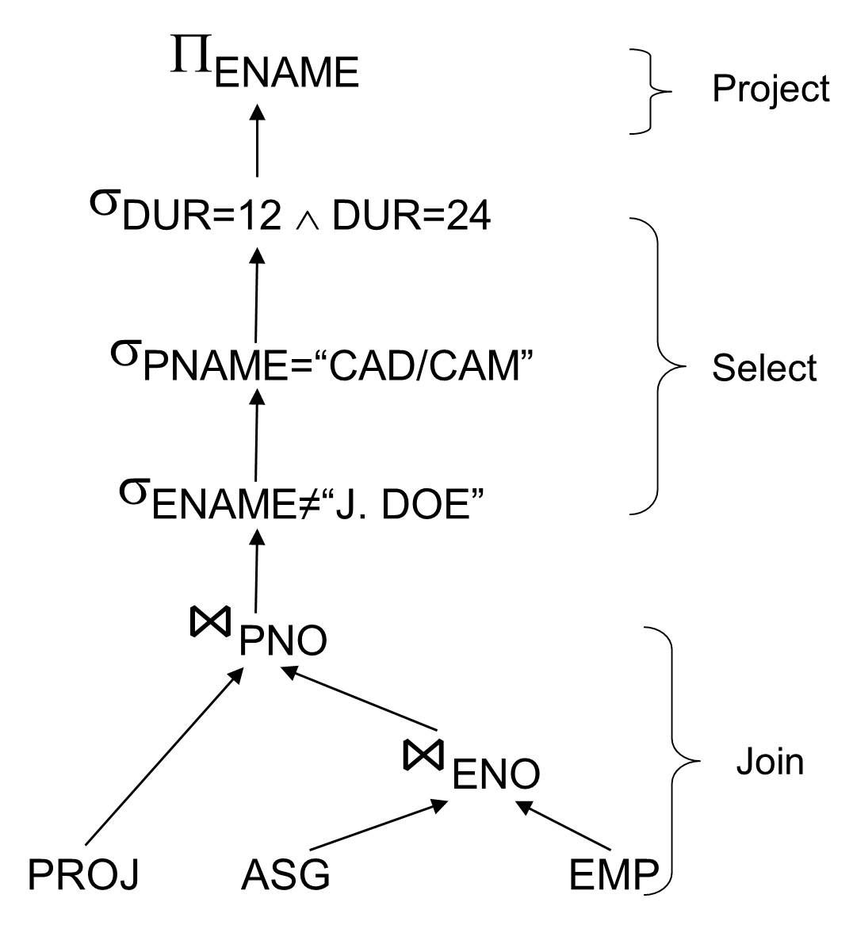
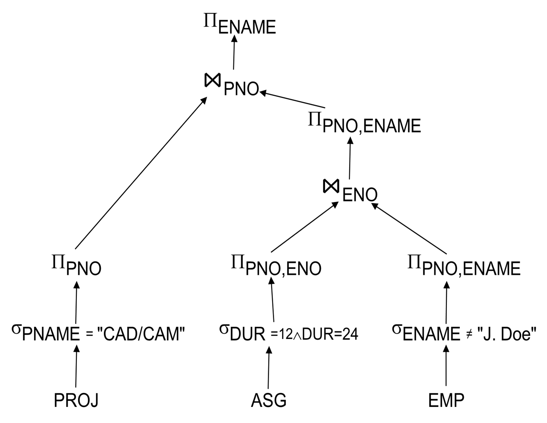
Restructuring
Notes:
The left-side tree is converted to the right-hand side tree.
The right-hand side is better and faster because it is doing selection first.
To convert we have some rules iteratively which is not easy.
Rules – slide 30

Slide 35
Distributed Query Processing Methodology

Slide 36
Query Processing in Three Steps
Global query is decomposed into local queries
Each local query is translated into queries over the corresponding local database system
Results of the local queries are combined into the answer
Schema Integration
Local Schema 1
Local Schema 2
Local Schema 3
Translator 1
Translator 2
Translator 3
InS₁
InS₂
InS₃
INTEGRATOR
GCS
Notes:
Each site has a different schema, operating system, databases(MySQL, Postgres, etc), storage techniques, and attribute names(ENO, Enumber, etc).
For Example: Local Schema 1 is Spanish, Local Schema 2 is German, Local Schema 3 is French and the use is English, so that’s a problem, what to do? - Translate
InS1, InS2 and InS3 are English.
After that again converted from English to Spanish, German, and French

Slide 37
Query Processing in Three Steps
Schema Integration
1. Global query is decomposed into local queries
Local Schema 1
Local Schema 2
Local Schema 3
Translator 1
Translator 2
Translator 3
InS₁
^{Q}1,1
InS₂
InS₃
^{Q}1,2
^{Q}1,3
INTEGRATOR
Q₁
GCS

Slide 38
Query Processing in Three Steps
2. Each local query is translated into queries over the corresponding local database system
Schema Integration
Local Schema 1
Local Schema 2
Local Schema 3
^{Q’}1,1
^{Q’}1,2
Q’
1,3
Translator 1
Translator 2
Translator 3
InS₁
^{Q}1,1
InS₂
InS₃
^{Q}1,2
^{Q}1,3
INTEGRATOR
Q₁
GCS

Slide 39
Query Processing in Three Steps
Schema Integration
3. Results of the local queries are combined into the answer
Local Schema 1
Local Schema 2
Local Schema 3
^{Q’}1,3
^{Q’}1,1
^{Q’}1,2
Translator 1
Translator 2
Translator 3
Final
answer
InS₁
^{Q}1,1
InS₂
InS₃
Combine
^{Q}1,2
^{Q}1,3
INTEGRATOR
Q₁
GCS

Slide 40

Query Decomposition
Overview
Global Query
Query decomposition &
global optimization
. . .
…
SQ_{n}
PQ₁ PQ_{n}
SQ₁
SQ₂
…
SQ_{i} export schema subquery
in global query language
TQ_{i} target query (local subquery) in local query language
PQ_{i} postprocessing query used to combine results returned by subqueries to form the answer
Query
translator 1
Query
translator 2
Query
translator n
. . .
TQ₁
TQ₂
TQ_{n}
DB₁
DB₂
DB_{n}

Slide 41
Query Decomposition Example

Slide 42
Assumptions
To simplify the discussion, we assume that there are only two export (local) schemas:
ES1 ES2
Emp1: | SSN | Emp2: | SSN
 | Name Salary Age |  | Name Salary Rank
Notes:
The idea is if we have 2 local queries how to make it global?

Slide 43
Outerjoin
Review:
The outerjoin of relation R₁ and R₂ (R₁ ⋈_{o} R₂ ) is the union of three components:
– the join of R₁ and R₂,
dangling tuples of R₁
values, and
dangling tuples of R₂
values.
padded with null
padded with null
Notes:
This is the full outer join.

Slide 44
Outerjoin Example
EmpO
OID | SSN | Name | Salary | Age | Rank
1 | 2222 | Ahad | 98,000 | null | S. Mgr.
2 | 7531 | Wang | 95,000 | mull | S. Mgr.
3 | 6789 | Smith | Incon- sistent | 40 | Mgr.
4 | 4321 | Chang | 62,000 | 30 | null
5 | 8642 | Patel | 75,000 | 35 | null
Emp1
OID | SSN | Name | Salary | Age
3 | 6789 | Smith | 90,000 | 40
4 | 4321 | Chang | 62,000 | 30
5 | 8642 | Patel | 75,000 | 35
Emp2
OID | SSN | Name | Salary | Rank
1 | 2222 | Ahad | 98,000 | S. Mgr.
2 | 7531 | Wang | 95,000 | S. Mgr.
3 | 6789 | Smith | 25,000 | Mgr.
EmpG = (OID, SSN, Name, Salary) from EmpO
Dangling Tuple
Dangling Tuple
Notes:
Outer join combines the two tables.
Smith’s salary should be added – 90000+25000 -> But the database doesn’t know. So we need to put some rules (Rule is Aggregate function – sum in this case).
EmpG (’G’ means general)
Emp1 and Emp2 -> Physically exist, but EmpO is a schema

Slide 45
Inconsistency Resolution
The schema integration techniques work as long as there is no data inconsistency
If data inconsistency occurs, aggregate functions may be used to resolve the problem.

Slide 46
Generalization Example
Emp1: | SSN | Emp2: | SSN | EmpG: | SSN
 | Name |  | Name |  | Name
 | Salary |  | Salary |  | Salary
 | Age |  | Rank
Emp1 and Emp2 will also appear in the global schema since not all information in Emp1 and Emp2 is retained in EmpG
Generalization
EmpG
SSN
Name Salary
More
specific
Emp1
Age
_{Rank} Emp2

Slide 47
Definitions
type:
Given a class C, the type
of C denoted by type(C ), is the
set of attributes defined for C and their corresponding domains.
world:
the world of C, denoted
by world(C ), is the set of real-
world objects described by C.
extension:
the extension of C,
denoted by extension(C ), is the
set of instances contained in C.

Slide 48


Inconsistency Resolution Example
Export Schemas Integrated Schema
Emp1: SSN | Emp2: | SSN | EmpG: | SSN |  | EmpO: | SSN
Name Salary |  | Name Salary |  | Name Salary | or |  | Name Salary
Age Rank
Generalization
Age Rank
Outer join
Aggregate Functions - Examples:
EmpG.Name = Emp1.Name, if EmpG is in world(Emp1)
= Emp2.Name, if EmpG is in world(Emp2) – world(Emp1) EmpG.Salary = Emp1.Salary, if EmpG is in world(Emp1) – world(Emp2)
= Emp2.Salary, ifEmpG is in world(Emp2) – world(Emp1)
= Sum(Emp1.Salary, Emp2.Salary), if EmpG is in world(Emp1) ⋂ world(Emp2)
EmpO.Age = Emp1.Age, if EmpO is in world(Emp1)
= Null, if EmpO is in world(Emp2) – world(Emp1) EmpO.Rank = Emp2.Rank, if EmpO is in world(Emp2)
= Null, if EmpO is in world(Emp1) – world(Emp2)
world(Emp2) –
world(Emp1)
⋂
world(Emp2)
world(Emp1) –
world(Emp2)
world(Emp1)
World (Emp1)
World (Emp2)
Notes:
Emp1 and Emp2 are local
EmpG and EmpO are global
If a query is asking Name and Salary then EmpG can answer.
If a query is asking Age and Rank then EmgO can answer.

Slide 49
Query Decomposition Example
Step 1: Determine Number of Subqueries
Global | Select | EmpO.Name, EmpO.Rank
Query | From | EmpO
Where
EmpO.Salary > 80,000 AND EmpO.Age > 35
Obtain a partition of world(EmpO) based on the aggregate
function used to resolve the data inconsistency.
Option 1 (based on Salary)
part. 1: world(Emp1) – world(Emp2) part. 2: world(Emp2) – world(Emp1) part. 3: world(Emp1) ⋂ world(Emp2)
Inconsistency Function:
EmpO.Salary = Emp1.Salary, if
EmpG is in world(Emp1) – world(Emp2)
= Emp2.Salary, if
EmpG is in world(Emp2) – world(Emp1)
= Sum(Emp1.Salary,Emp2.Salary), if EmpG is in world(Emp1) ⋂ world(Emp2)
world(Emp1)
3
2
1
world(Emp2)
Notes:
If salary is in both tables then both must answer that – part 3
Part 1 is Emp1
Part 2 is Emp2
Part 3 is both Emp1 and Emp2

Slide 50
Query Decomposition Example
Step 1: Determine Number of Subqueries
Global | Select | EmpO.Name, EmpO.Rank
Query | From | EmpO
Where
EmpO.Salary > 80,000 AND EmpO.Age > 35
Option 2 (based on Age)
part. 1: world(Emp1)
part. 2: world(Emp2) – world(Emp1)
Inconsistency Function: EmpO.Age
= Emp1.Age, if EmpO is in world(Emp1)
= Null, if EmpO is in world(Emp2) – world(Emp1)
world(Emp1)
2
world(Emp2)
1

Slide 51
Query Decomposition Example
Step 1: Determine Number of Subqueries
Global | Select | EmpO.Name, EmpO.Rank
Query | From | EmpO
Where
EmpO.Salary > 80,000 AND EmpO.Age > 35
Option 1 (based on Salary)
part. 1: world(Emp1) – world(Emp2) part. 2: world(Emp2) – world(Emp1) part. 3: world(Emp1) ⋂ world(Emp2)
world(Emp1)
Option 2 (based on Age)
part. 1: world(Emp1) part. 2: world(Emp2) –
world(Emp1)
world(Emp1)
3
2
world(Emp2)
2
world(Emp2)
1
1
We use Option 1 since it is the finest partition among all the partitions.

Slide 52
Query Decomposition Example Another Example
Option 2:
world(Emp1)
Option 3:
world(Emp1)
2
world(Emp2)
2
world(Emp2)
1
1
Use finer partition (Option 1):
world(Emp1)
3
2
world(Emp2)
1
Notes:
Option 1 and 2 cannot handle overlap part -> So why don’t we divide it into 3 parts.

Slide 53
Query Decomposition Example
Step 2: Query Decomposition
part. 1: Select Emp1.Name
Global Query:
Select EmpO.Name, EmpO.Rank
From Emp1
Where Emp1.Salary > 80,000 AND Emp1.Age > 35 AND Emp1.SSN NOT IN
(Select Emp2.SSN
From Emp2)
part. 2: This subquery is discarded because EmpO.Age is Null.
From EmpO
Where EmpO.Salary > 80,000 AND EmpO.Age > 35
Partition:
1
3
2
world(Emp2)
world(Emp1)
part. 3: Select Emp1.Name, Emp2.Rank
From Emp1, Emp2
Query Decomposition: Obtain a query for each subset in the chosen partition.
Where Sum(Emp1.Salary,
Emp2.Salary) > 80,000 AND
Emp1.Age > 35 AND
Emp1.SSN = Emp2.SSN
EmpO.Age = Emp1.Age, if EmpO is in world(Emp1)
= Null, if EmpO is in world(Emp2) – world(Emp1)
EmpO.Salary = Emp1.Salary, if EmpG is in world(Emp1) – world(Emp2)
= Emp2.Salary, ifEmpG is in world(Emp2) – world(Emp1)
= Sum(Emp1.Salary, Emp2.Salary), if EmpG is in world(Emp1) ⋂ world(Emp2)
Notes:
Part-1 means Emp1 can answer.

Slide 54
Query Decomposition Example
Step 3: Further Decomposition
Some resulting query may still reference
STEP 3:
data from more than one database. They need to be further decomposed into subqueries and possibly also postprocessing queries
Select Emp1.Name
From Emp1
Where Emp1.Salary > 80,000 and Emp1. Age > 35 and Emp1.SSN NOT IN X
Before STEP 3: Select Emp1.Name
From Emp1
Where Emp1.Salary > 80,000 and Emp1. Age > 35 and Emp1.SSN NOT IN
(Select Emp2.SSN From Emp2)
X
Insert INTO X Select Emp2.SSN From Emp2)

Slide 55
Query Decomposition Example
Step 4: Query Optimization
STEP 4: It may be desirable to reduce the number of subqueries by combining subqueries for the same database.

Slide 56
Distributed Query Processing Methodology

Slide 57
Data Localization
Input: Algebraic query on distributed relations
Restructuring using fragments
Determine which fragments are involved
Localization is performed by the following reductions:
Reduction for Primary Horizontal Fragmentation
Reduction for Derived Fragmentation
Reduction for Vertical Fragmentation
Reduction for Hybrid Fragmentation
Notes:
Now we have decomposed query – now we can do these things.

Slide 58
Example
Assume
EMP is fragmented as follows:
EMP₁= σ_{ENO≤“E3”}(EMP)
EMP₂= σ_{“E3”<ENO≤“E6”}(EMP)
EMP₃= σ_{ENO≥“E6”}(EMP)
ASG fragmented as follows:
ASG₁= σ_{ENO≤“E3”}(ASG)
ASG₂= σ_{ENO>“E3”}(ASG)
Π_{ENAME}
σ_{DUR=12 ∧DUR=24}
σ_{PNAME=“CAD/CAM”}
σ_{ENAME≠“J. DOE”}
⋈_{PNO}
⋈_{ENO}
PROJ
∪
∪
EMP₁
EMP₂
EMP₃
ASG₁
ASG₂
Notes:
Emp1, Emp2, and Emp3 are Horizontally Framented.
Similarly with ASG1 and ASG2

Slide 59
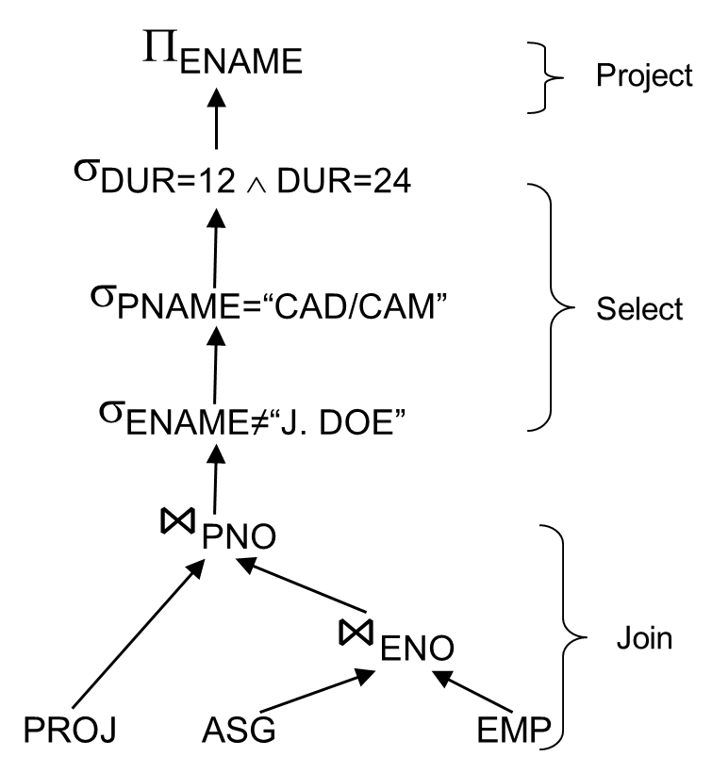
Example
In any query
Replace EMP by (EMP₁ ∪ EMP₂ ∪ EMP₃)
Replace ASG by (ASG₁ ∪ ASG₂)
Π_{ENAME}
σ_{DUR=12 ∧DUR=24}
σ_{PNAME=“CAD/CAM”}
σ_{ENAME≠“J. DOE”}
⋈_{PNO}
⋈_{ENO}
PROJ
∪
∪
EMP₁
EMP₂
EMP₃
ASG₁
ASG₂

Slide 60
Provides Parallellism
∪
…..
⋈_{ENO}
⋈_{ENO}
⋈_{ENO}
⋈_{ENO}
EMP₁
ASG₁
EMP₂
ASG₂
EMP₃
ASG₁
EMP₃
ASG₂

Slide 61
Eliminates Unnecessary Work
∪
⋈_{ENO}
⋈_{ENO}
⋈_{ENO}
EMP₁
ASG₁
EMP₂
ASG₂
EMP₃
ASG₂
Notes:
Only theses cases make sense and rest are useless.

Slide 62
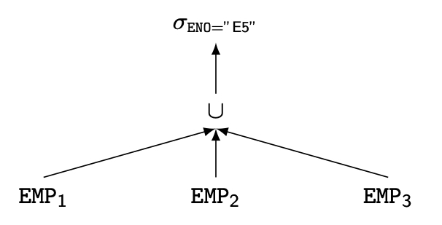
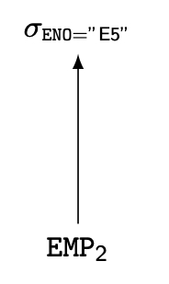
Reduction for PHF
Reduction with selection
Relation R and F_{R}={R₁, R₂, …, R_{w}} where R_{j}=σ_{pj}(R)
σ_{pi}(R_{j})=∅ if ∀x in R: ¬(p_{i}(x)∧ p_{j}(x))
SELECT *
FROM EMP
WHERE ENO="E5"

Slide 63
Reduction for PHF
Reduction with join
Possible if fragmentation is done on join attribute
Distribute join over union
(R₁∪ R₂)⋈S ⇔ (R₁⋈S) ∪ (R₂⋈S)

Slide 64
Reduction for PHF
Example of Reduction with join
Assume EMP is fragmented as before and
ASG₁: σ_{ENO ≤ "E3"}(ASG)
ASG₂: σ_{ENO > "E3"}(ASG)
Consider the query
SELECT *
FROM EMP NATURAL JOIN ASG
Distribute join over unions
Apply the reduction rule
▷◁ _{ENO}
∪
∪
EMP₁
EMP₂
EMP₃
ASG₁
ASG₂
∪
▷◁ _{ENO}
▷◁ _{ENO}
▷◁ _{ENO}
EMP₁
ASG₁
EMP₂
ASG₂
EMP₃
ASG₂
Notes:
The bottom one is efficient because there are some pairs that do not generate some results.

Slide 65
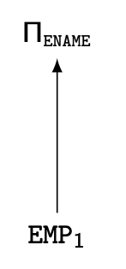
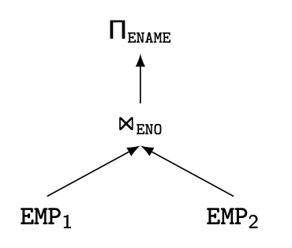
Reduction for VF
Find useless (but not empty) intermediate relations
Relation R defined over attributes A = {A₁, ..., A_{n}} vertically fragmented as R_{i} =Π_{A'}(R) where A'⊆ A:
Π_{D,K}(R_{i}) is useless if the set of projection attributes D is not in A'
Example: EMP₁ = Π_{ENO,ENAME} (EMP); EMP₂ = Π_{ENO,TITLE} (EMP)
SELECT ENAME
FROM EMP
Notes:
ENAME is only in Emp1 so we do not need to join.

Slide 66
Reduction for DHF
Rule :
Distribute joins over unions
Apply the join reduction for horizontal fragmentation
Example
ASG₁: ASG ⋉_{ENO} EMP₁
ASG₂: ASG ⋉_{ENO} EMP₂
EMP₁: σ_{TITLE = “Programmer”} (EMP)
EMP₂: σ_{TITLE ≠ “Programmer”} (EMP)
Query
SELECT *
FROM EMP NATURAL JOIN ASG
WHERE EMP.TITLE = "Mech. Eng."
Notes:
Primary horizontal fragmentation is applied on Emp1 and Emp2
ASG1 and ASG2 are Derived horizontal Fragmeention
The alpha symbol is Semi Join -> ENO is the common attribute.

Slide 67
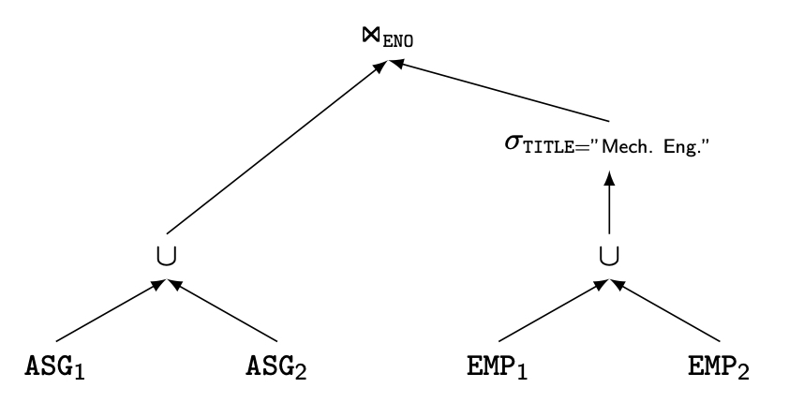
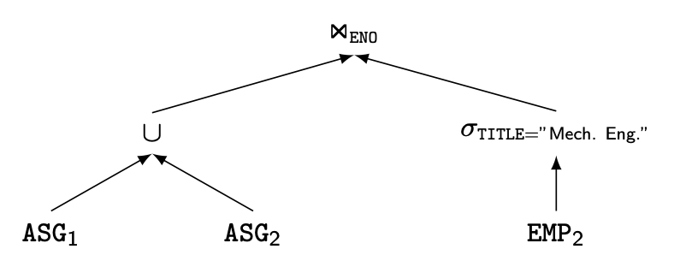
Reduction for DHF
Generic query
Selections first

Slide 68
Reduction for DHF
Selections first
⋈_{ENO}
∪
σ_{TITLE=“Mech. Eng.”}
ASG₁
ASG₂
EMP₂
Joins over unions
∪
⋈_{ENO}
⋈_{ENO}
σ_{TITLE=“Mech. Eng.”}
σ_{TITLE=“Mech. Eng.”}
ASG₁
EMP₂
ASG₂
EMP₂
Notes:
Selection first is best because the number of tuples gets reduced.

Slide 69
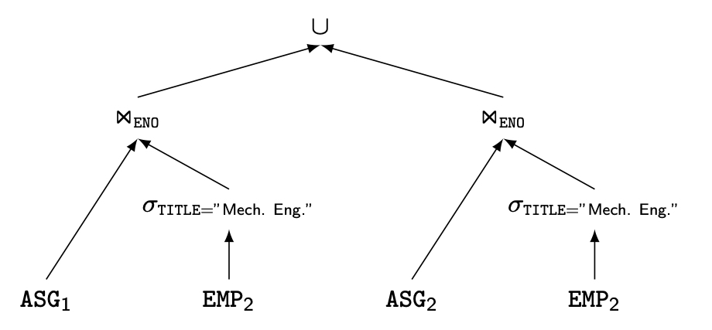
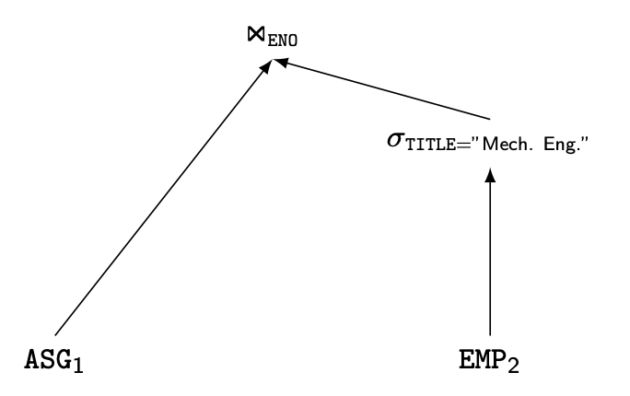
Reduction for DHF
Joins over unions
Elimination of the empty
intermediate relations
(left sub-tree)

Slide 70
Reduction for Hybrid Fragmentation
Combine the rules already specified:
Remove empty relations generated by contradicting selections on horizontal fragments;
Remove useless relations generated by projections on vertical fragments;
Distribute joins over unions in order to isolate and remove useless joins.

Slide 71
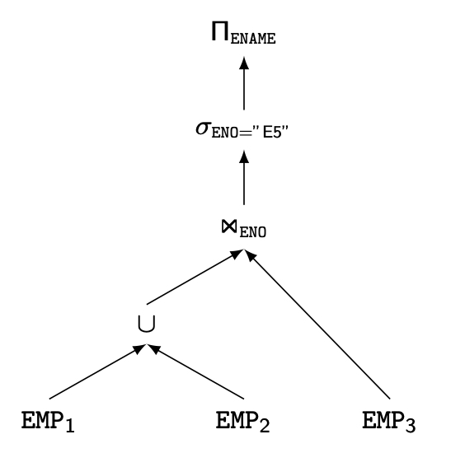
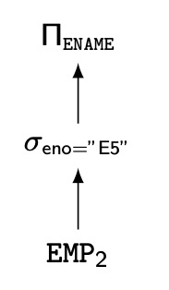
Reduction for HF
Example
Consider the following hybrid fragmentation:
EMP₁= σ_{ENO≤"E4"} (Π_{ENO,ENAME} (EMP))
EMP₂= σ_{ENO>"E4"} (Π_{ENO,ENAME} (EMP))
EMP₃= σ_{ENO,TITLE} (EMP)
and the query
SELECT ENAME
FROM EMP
WHERE ENO="E5"
⇒

Slide 72
Outline
Distributed Query Processing
Overview
Query Modification
Query Decomposition
Data Localization
Query Translation
Distributed Cost Model
Distributed Query Optimization
Join Ordering
Dynamic Approach
Static Approach
Hybrid Approach
Adaptive Query Processing

Slide 73
Query Translation (1)
IF Global Query Language ≠
Local Query Language
THEN
Export Schema Subquery
Local Query Language
Translator

Slide 74
Query Translation (2)
IF the source query language has a higher
expressive power THEN EITHER
Some source queries cannot be translated; or
they must be translated using both
the syntax of the target query language, and
some facilities of a high-level programming language.
Example: A recursive OODB query may not be translated into a relational query using SQL alone.

Slide 75
Relation-to-OO Translation
OODB Schema:
Auto
OID
Company
OID
People
OID
City
OID
Name
State
Color Manufacturer
Name Profit
Name
Hometown
Headquarter
Automobile Age
President
Equivalent Relational Schema:
Auto (Auto-OID, Color, Company-OID)
Company (Company-OID, Name, Profit, City-OID, People-OID)
People (People-OID, Name, Age, City-OID, Auto-OID)
City (City-OID, Name, State)
Notes:
One is using relational query language and the other is using object-oriented language.
Both language have same number of tables and attributes, just the representation is different.

Slide 76
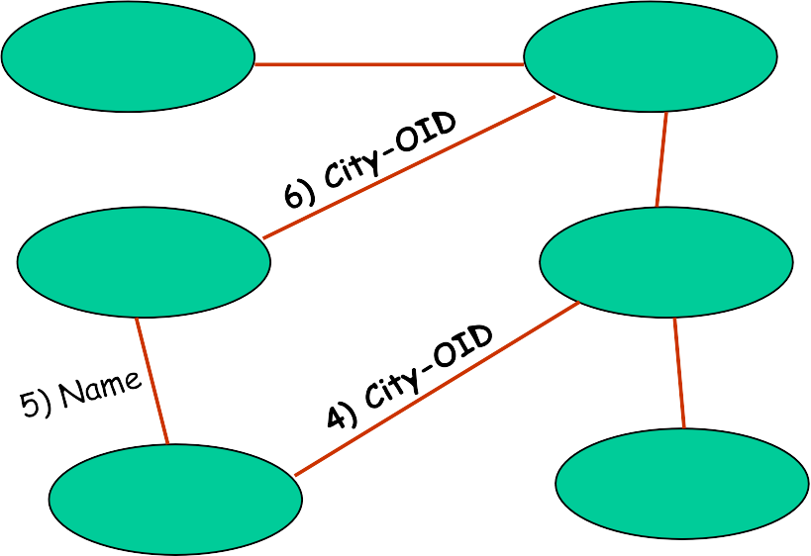
Relational-to-OO Example (1)
Global Query:
Relational Predicate Graph:
Select
From
Auto1.*
Auto Auto1, Auto Auto2, Company, People,
City City1, City City2
Auto1.Conmpany-OID =
Company.Company-OID AND
Company.People-OID = People.People-OID AND
People.Age = 52 AND
People.Auto-OID =
Auto2.Auto-OID AND
Auto2.Color = “red” AND
People.City-OID = City1.City-OID AND
City1.Name = City2.Name AND
Company.City-OID =
City2.City-OID
Auto1
1) Company-OID
Company
People-OID
People
Age=52
Auto-OID
Auto2
Color=red
Find all red cars own by (3) a 52 year old who is the President (2) of the car manufacturer (1) and lives (4) in the same city (5) of the car manufacturer (6)
City2
Where
1
2
3
4
5
6
City1
Notes:
Why do we have 2 auto and 2 city? – Because we need to have 2 variables pointing to the same table.
Join – red color, selection – blue color.

Slide 77
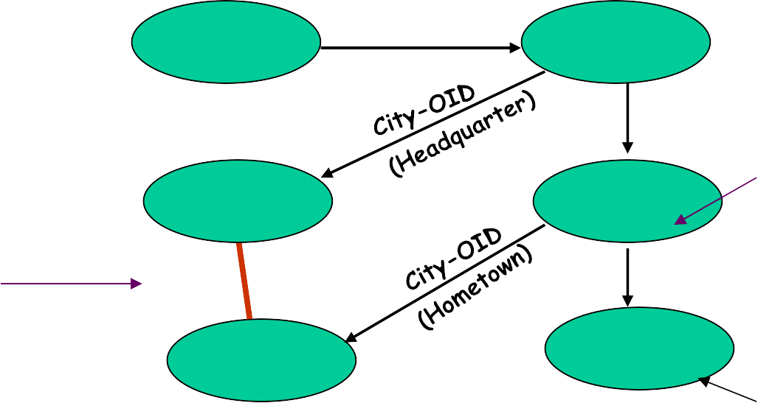
Relational-to-OO Example (2)
OO Predicate Graph:
Auto1
Company-OID
Company
People-OID
People
Age=52
Predicate 1
City1
Predicate 3
Auto-OID
Auto2
Color=red
City2
Predicate 2
OO Query:
Where Auto.Manufacturer.President.Age = 52 AND Auto.Manufacturer.President.Automobile.Color = red AND Auto.Manufacturer.Headquarter.Name =
Auto.Manufacturer.President.Hometown.Name
(1), (2) and (3)
(4), (5) and (6)

Slide 78
Cost model
I/O cost + CPU cost + communication cost
The communication cost component is probably the most important factor considered in distributed databases.
However, modern distributed processing environments have much faster communication networks, whose bandwidth is comparable to that of disks.
These might have different weights in different distributed environments (LAN vs WAN) since they all contribute significantly to the total cost of evaluating a query
Notes:
Cost -> How long it takes
In centralized – communication cost is not considered because we assume all things are in one place.

Slide 79
Network Topology
Wide area networks (WAN)
Characteristics
Relatively low bandwidth (compared to local CPU/IO)
High protocol overhead
Communication cost may dominate; ignore all other cost factors
Global schedule to minimize communication cost
Local schedules according to centralized query optimization
Local area networks (LAN)
Communication cost not that dominant
Total cost function should be considered
Special algorithms exist for some (i.e., star and satellite) networks

Slide 80
Complexity of Relational Operations for Cost Model
Operation
Complexity
Select
Project
O(n)
Assume
Relations of cardinality n
Sequential scan
(without duplicate elimination)
Project
(with duplicate elimination)
O(n ∗ log n)
Group
Join
Semi-join
O(n ∗ log n)
Division
Set Operators
Cartesian Product
O(n²)
Notes:
O(n): n – number of tuples

Slide 81
Distributed Cost Model
Cost functions
Total Time (or Total Cost)
Reduce each cost (in terms of time) component individually
Do as little of each cost component as possible
Optimizes resource utilization and increases system throughput
Response Time
Do as many things as possible in parallel
May increase total time because of increased total activity

Slide 82
Total Time
Total time = CPU cost + I/O cost + com. Cost
The summation of all cost factors
CPU cost = unit instruction cost ∗ no. of instructions
I/O cost = unit disk I/O cost ∗ no. of disk I/Os
com. cost = message initiation + transmission

Slide 83
Total Time
Total time = T_{CPU} ∗ no. of instructions
+ T _{I/O} ∗ no. of disk I/Os
+ T_{MSG} ∗ no. of messages
+ T_{TR} ∗ no. of bytes
T_{CPU} = the time of a CPU instruction
T _{I/O} = the time of a disk I/O
T_{MSG} = the fixed time of initiating and receiving a message
T_{TR} = the time to transmit a data unit (byte) from one site to another

Slide 84
Response Time
Response time = CPU time + I/O time + com. Time
Must consider parallel execution
CPU time = unit instruction time * no. of sequential instructions
I/O time = unit I/O time * no. of sequential I/Os
com. time = unit msg initiation time * no. of sequential msgs
+ unit transmission time * no. of sequential bytes

Slide 85
Response Time
Total time = T_{CPU} ∗ no. of sequential instructions
+ T _{I/O} ∗ no. of sequential disk I/Os
+ T_{MSG} ∗ no. of sequential messages
+ T_{TR} ∗ no. of sequential bytes
T_{CPU} = the time of a CPU instruction
T _{I/O} = the time of a disk I/O
T_{MSG} = the fixed time of initiating and receiving a message
T_{TR} = the time to transmit a data unit (byte) from one site to another

Slide 86
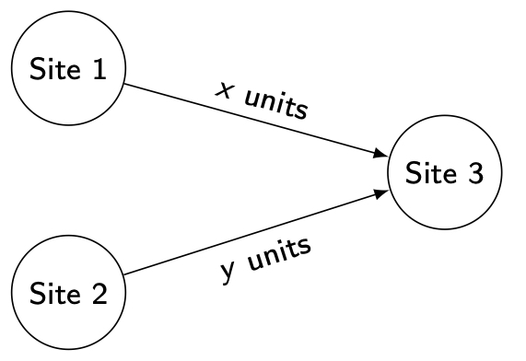
Example
Consider communication cost only
Total time =
2 × msg initialization time + unit transmission time * (x+y)
Response time =
max {time to send x from 1 to 3, time to send y from 2 to 3}

Slide 87
Query Optimization Issues – Statistics
The effectiveness of query optimization relies on accurate cost estimation which relies on statistics on the database.
The accuracy of statistics is achieved by periodic updating
Relation
Cardinality
Size of a tuple
Fraction of tuples participating in a join with another relation
Attribute
Cardinality of domain
Actual number of distinct values

Slide 88
Distributed Cost Model - Database Statistics
When a subsequent operation is located at a different site, the intermediate relation must be transmitted over the network.
Therefore, it is of prime interest to estimate the size of the intermediate results of relational algebra operations in order to minimize the size of data transfers.
This estimation is based on statistical information about the base relations and formulas to predict the cardinalities of the results of the relational operations.
There is a direct trade-off between the precision of the statistics and the cost of managing them, the more precise statistics being the more costly

Slide 89
Database Statistics
Primary cost factor: size of intermediate relations
Need to estimate their sizes
Make them precise ⇒ more costly to maintain
Simplifying assumption: uniform distribution of attribute values in a relation
Notes:
Uniform distribution – all equal
Normal distribution – this is a typical distribution
Then why do we need to do uniform distribution because we don't have other option?

Slide 90
Statistics
For each relation R[A₁, A₂, …, A_{n}] fragmented as R₁, …, R_{r}
length of each attribute: length(A_{i})
the number of distinct values for each attribute in each fragment: card(Π_{Ai}R_{j})
maximum and minimum values in the domain of each attribute: min(A_{i}), max(A_{i})
the cardinalities of each domain: card(dom[A_{i}])
The cardinalities of each fragment: card(R_{j})
Selectivity factor (SF) of each operator on relations
uniform distribution

Slide 91
Intermediate Relation Sizes
Selection
card(σ_{F}(R)) = SF (σ_{F}(R)) ⋅ card(R)
where
1
SF( σ_{A = value} (R)) =
card(∏_{A}(R))
max(A) – value
SF( σ_{A > value} (R)) =
max(A) – min(A)
value – min(A)
SF( σ_{A < value} (R)) =
max(A) – min(A)
Notes:
These are estimations.
What is behind this? – Its uniform distribution.

Slide 92
Intermediate Relation Sizes
Projection
card(Π_{A}(R)) = card(R)
Cartesian Product
card(R ⋅ S) = card(R) * card(S)
Union
upper bound: card(R ∪ S) = card(R) + card(S)
lower bound: card(R ∪ S) = max{card(R), card(S)}
Set Difference
upper bound: card(R–S) = card(R)
lower bound: 0
Notes:
Duplicate is removed. Only one is outputted.

Slide 93
Intermediate Relation Size
Join
Special case: A is a primary key of R, and B is a foreign key of S
card(R ⋈_{A=B} S) = card(S)
More general:
card(R ⋈ S) = SF (R ⋈_{A=B} S) ∗ card(R) ∗ card(S),
Notes:
This is more important.

Slide 94
Histograms for Selectivity Estimation
For skewed data, an assumption of uniform distribution of attribute values yields inaccurate estimations
Use a histogram for each skewed attribute A
Histogram = set of buckets
Each bucket describes a range of values of A, with its average frequency f (number of tuples with A in that range) and number of distinct values d
Buckets can be adjusted to different ranges
Examples
Equality predicate
With value in Range_{i}, we have: SF_{S} (A = value) = 1/d_{i}
Range predicate
Requires identifying relevant buckets and summing up their frequencies
Notes:
Histogram for statistic tool

Slide 95
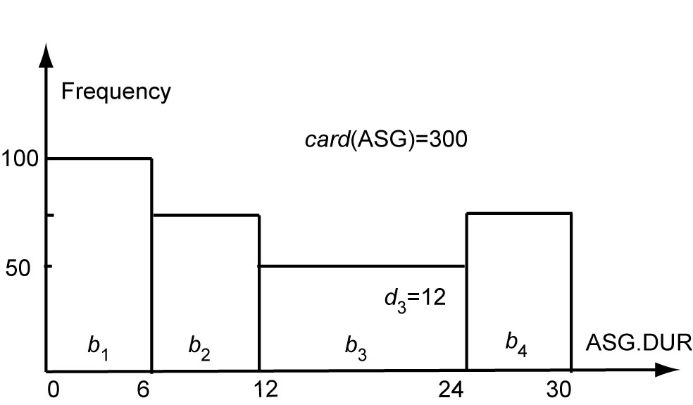
Histogram Example
It shows a possible 4-bucket histogram for attribute DUR of a relation ASG with 300 tuples.
Let us consider the equality predicate ASG.DUR=18.
Since the value ”18” fits in bucket b₃, the selectivity factor is 1/12.
Since the cardinality of b₃ is 50, the cardinality of the selection is 50/12 (= 4.166) which is approximately 5 tuples. (i.e., 300/30 = 10 tuples)
Notes:
Important for exam
The x-axis is the duration – month or year
The y-axis is frequency – 100 people or generally 100 tuples
100 + 75 + 50 + 75 = 300
1/12 why? => 24 - 12 = 12
300/30 = 10 tuples => If we don’t have any histogram.(Assuming uniform distribution)

Slide 96
Histogram Example
It shows a possible 4-bucket histogram for attribute DUR of a relation ASG with 300 tuples.
Let us now consider the range predicate ASG.DUR ≤ 18.
We have min(range 3) = 12 and max(range 3) = 24.
The cardinality of the selection is:
100 + 75 + (((18 − 12)/(24 − 12)) ∗ 50) = 200 tuples.
(i.e., 18/30 * 300 = 180 tuples if the histogram info. is not used)
Notes:
Check slide 91 also for formulae.

Slide 97

Assignment #2

